Slide 1
SICKLE CELL DISEASE
Dr. R.S.G.SOWMYA,
Assistant Professor
Dept of Pathology, SKHMC, kulasekharam

Slide 2
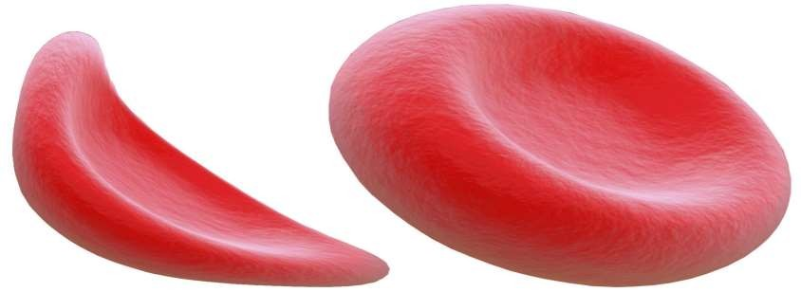
Sickle Cell Anemia
Is an inherited form of anemia — a condition in which there aren't enough healthy red blood cells to carry adequate oxygen throughout your body.
Normally, your red blood cells are flexible and round, moving easily through your blood vessels.

Slide 3
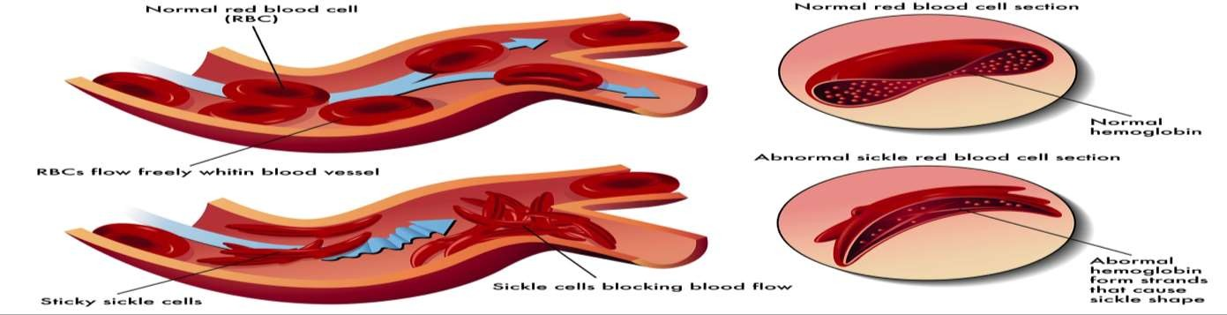
Sickle Cell Anemia
In sickle cell anemia, the red blood cells become rigid and
sticky and are shaped like sickles or crescent moons.
These irregularly shaped cells can get stuck in small blood vessels, which can slow or block blood flow and oxygen to parts of the body.

Slide 4
Definition
sickle or crescent shaped.
The effects of this condition due to an abnormality of the hemoglobin molecules found in erythrocytes.
Sickle disorder
Cell disease:
is
a genetic
that affects erythrocytes
(RBC) causing them to
become

Slide 5
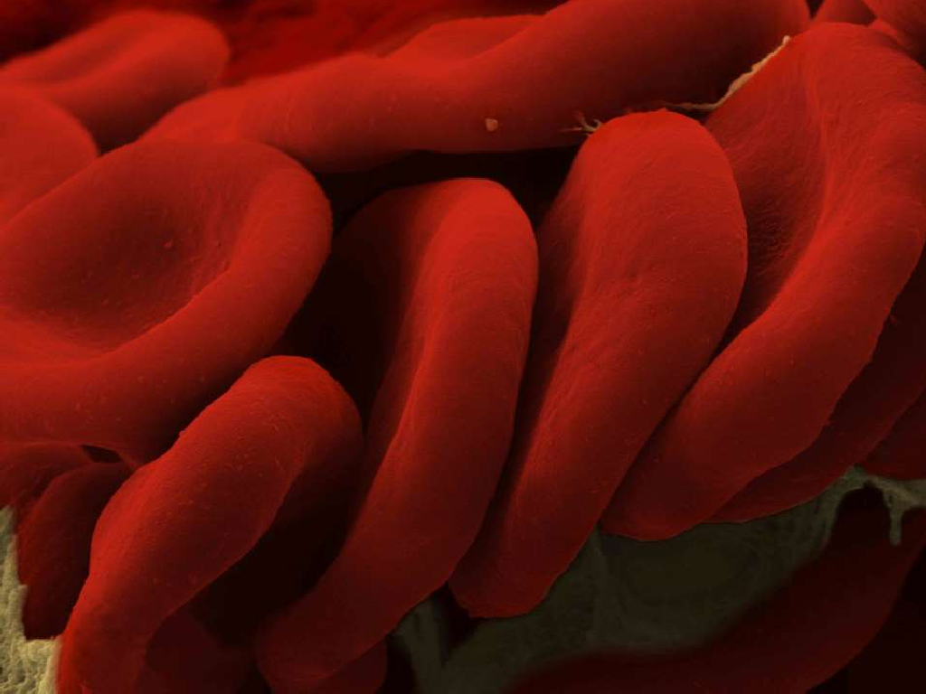













Red Blood Cells
Erythropoesis
Smooth and round
Squeeze through Capillaries
Contains Hemoglobin
Erythrocytes
Transports oxygen
No Nucleus
100 – 120
days

Slide 6
Hemoglobin
The oxygen-carrying pigment and predominant protein in the red blood cells.
Hemoglobin forms an unstable, reversible bond with oxygen.
Oxyhemoglobin: Oxygenated ( bright red).
Deoxyhemoglobin: Reduced ( purple-blue).

Slide 7
Hemoglobin
Each hemoglobin molecule is made up
groups surrounding a globin group.
of four heme
Heme contains iron and gives a red color to the molecule.
Globin consists of two linked pairs of polypeptide chains.

Slide 8
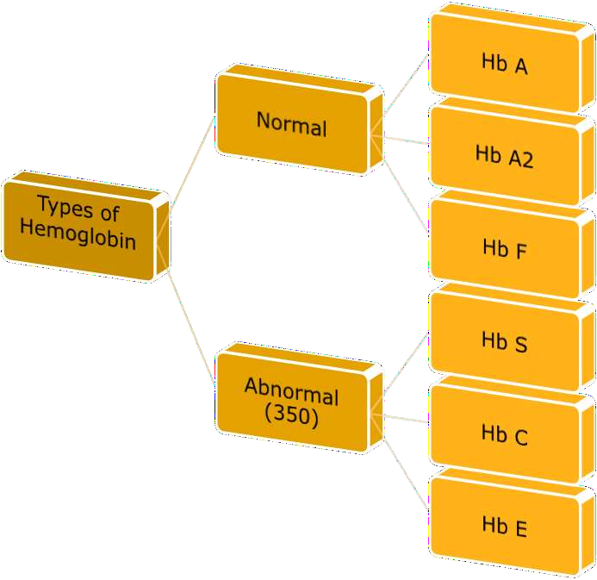

Slide 9
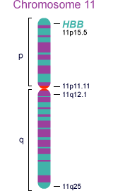

Genetics of SCD
The change in cell structure arises from a change in the structure of hemoglobin.
A single change in an amino acid causes hemoglobin to aggregate.

Slide 10
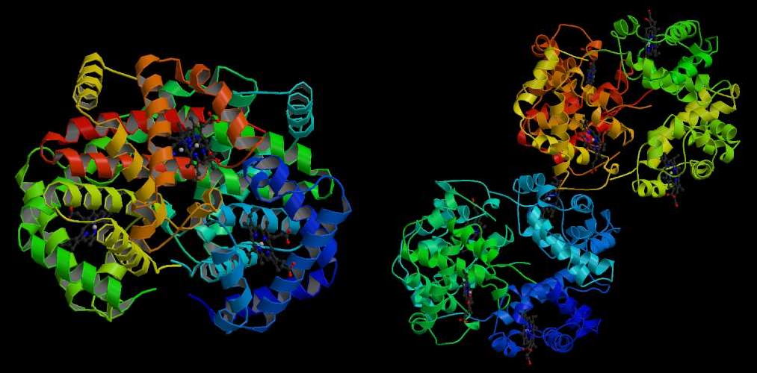
Hemoglobin S
Hemoglobin A

Slide 11
Inheritance of Sickle Cell Disease
If one parent has sickle cell trait (HbAS) and the other does not carry the sickle hemoglobin at all (HbAA) then none of the children will have sickle cell anemia.
There is a one in two (50%) chance that any given child will get one copy of the HbAS gene and therefore have the sickle cell trait.
It is equally likely that any given child will get two HbAA genes and be completely unaffected.

Slide 12
Inheritance of Sickle Cell Disease
If both parents have sickle cell trait (HbAS) there is a one in four (25%) chance that any given child could be born with sickle cell anemia.
There is also a one in four chance that any given child could be completely unaffected.
There is a one in two (50%) chance that any given child will get the sickle cell trait.

Slide 13
Inheritance of Sickle Cell Disease
If one parent has sickle cell trait (HbAS) and the other has sickle cell anemia (HbSS) there is a one in two (50%) chance that any given child will get sickle cell trait and a one in two (50%) chance that any given child will get sickle cell anemia.
No children will be completely
unaffected.

Slide 14
Inheritance of Sickle Cell Disease
If one parent has sickle cell anemia (HbSS) and the other is completely unaffected (HbAA) then all the children will have sickle cell trait.
None will have sickle cell
anemia.
The parent who has sickle cell anemia (HbSS) can only pass the sickle hemoglobin gene to each of their children.

Slide 15
Mechanism
When sickle hemoglobin (HbS) gives up its oxygen to the tissues, HbS sticks together
  Forms long rods form inside RBC
  RBC become rigid, inflexible, and sickle-shaped
  Unable to squeeze through small blood vessels, instead blocks small blood vessels
  Less oxygen to tissues of body
RBCs containing HbS have a shorter lifespan
  Normally 20 days
  Chronic state of anemia

Slide 16
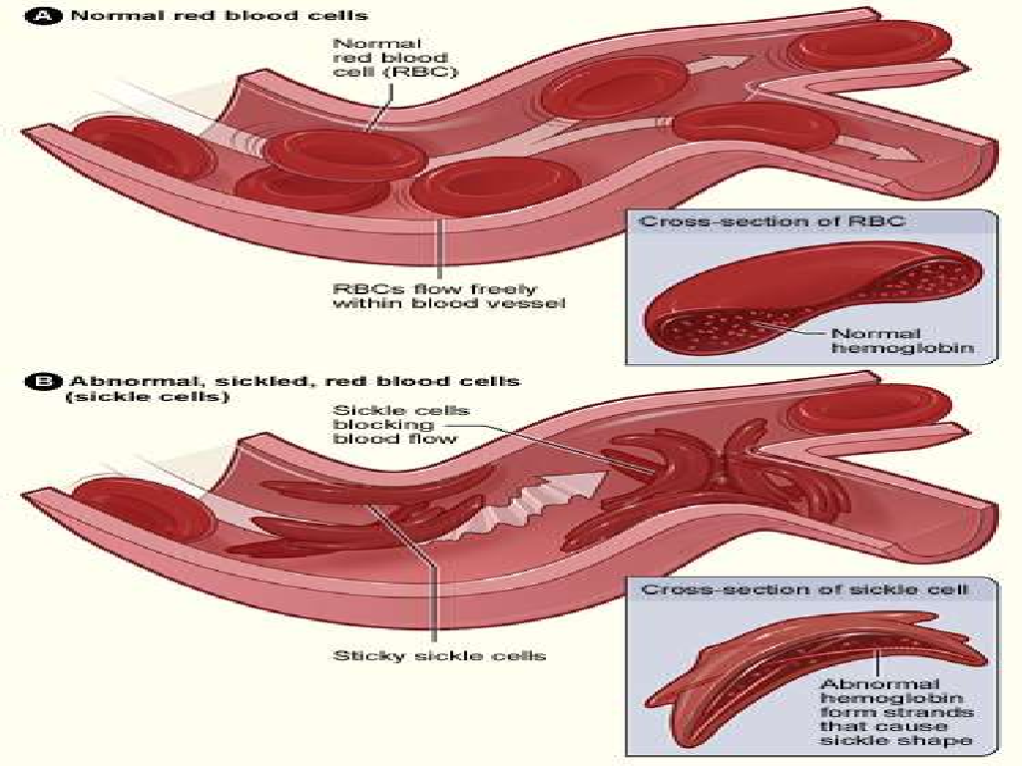

Slide 17

Symptoms
They vary from person to person and
change over time, include:
Anemia. Sickle cells break apart easily and die, leaving you without enough red blood cells. Red blood cells usually live for about 120 days before they need to be replaced. But sickle cells usually die in 10 to 20 days, leaving a shortage of red blood cells (anemia). Without enough red blood cells, your body can't get the oxygen it needs to feel energized, causing fatigue.

Slide 18

Symptoms
Episodes of pain. Periodic episodes of pain, called crises,
are a major symptom of sickle cell anemia.
Pain develops when sickle-shaped red blood cells block blood flow through tiny blood vessels to your chest, abdomen and joints. Pain can also occur in your bones.
The pain varies in intensity and can last for a few hours to a few weeks. Some people have only a few pain episodes. Others have a dozen or more crises a year. If a crisis is severe enough, you might need to be hospitalized. Some adolescents and adults with sickle cell anemia also have chronic pain, which can result from bone and joint damage, ulcers and other causes.

Slide 19
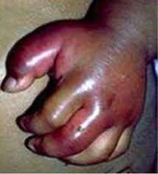
Symptoms
Painful swelling of hands and feet. The swelling is caused by sickle-shaped red blood cells blocking blood flow to the hands and feet.
Frequent infections. Sickle cells can damage an organ that fights infection (spleen), leaving you more vulnerable to infections.

Slide 20

Symptoms
Delayed growth. Red blood cells provide your body with the oxygen and nutrients you need for growth. A shortage of healthy red blood cells can slow growth in infants and children and delay puberty in teenagers.
Vision problems. Tiny blood vessels that supply your eyes may become plugged with sickle cells. This can damage the retina
— the portion of the eye that
processes visual images, leading
to vision problems.

Slide 21
Complications
Sickle cell anemia can lead to a host of complications, including:
Stroke. A stroke can occur if sickle cells block blood flow to an area of your brain. Signs of stroke include seizures, weakness or numbness of your arms and legs, sudden speech difficulties, and loss of consciousness. If your baby or child has any of these signs and symptoms, seek medical treatment immediately. A stroke can be fatal.
Acute chest syndrome. This life-threatening complication causes chest pain, fever and difficulty breathing. Acute chest syndrome can be caused by a lung infection or by sickle cells blocking blood vessels in your lungs. It might require emergency medical treatment with antibiotics and other treatments.
Pulmonary hypertension. People with sickle cell anemia can develop high blood pressure in their lungs (pulmonary hypertension). This complication usually affects adults rather than children. Shortness of breath and fatigue are common symptoms of this condition, which can be fatal.

Slide 22
Complications
Organ damage. Sickle cells that block blood flow through blood vessels immediately deprive the affected organ of blood and oxygen. In sickle cell anemia, blood is also chronically low on oxygen. Chronic deprivation of oxygen-rich blood can damage nerves and organs in your body, including your kidneys, liver and spleen. Organ damage can be fatal.
Blindness. Sickle cells can block tiny blood vessels that supply your eyes. Over time, this can damage the portion of the eye that processes visual images (retina) and lead to blindness.
Leg ulcers. Sickle cell anemia can cause open sores, called ulcers, on your legs.
Gallstones. The breakdown of red blood cells produces a substance called bilirubin. A high level of bilirubin in your body can lead to gallstones.

Slide 23
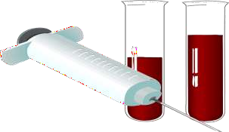
Diagnosis
A blood test can check for hemoglobin S — the defective form of hemoglobin that underlies sickle cell anemia. In the United States, this blood test is part of routine newborn screening done at the hospital. But older children and adults can be tested, too.
In adults, a blood sample is drawn from a vein in the arm. In young children and babies, the blood sample is usually collected from a finger or heel.
If the screening test is negative, there is no sickle cell gene present.
If the screening test is positive, further tests will be done to
determine whether one or two sickle cell genes are present.
Check for a low red blood cell count (anemia) will be done.

Slide 24
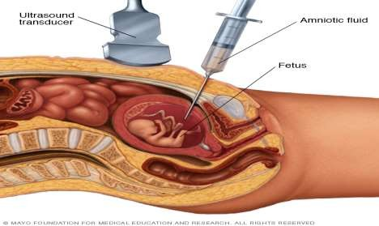
Genetic counseling
Two tests can be used to help expectant parents find out if
their child is affected.
1. Amniocentesis, done usually at 14-16 weeks of pregnancy, tests a sample of the amniotic fluid in the womb for genetic defects (the fluid and the fetus have the same DNA). Under local anesthesia, a thin needle is inserted through the woman's abdomen and into the womb. About 20 milliliters of fluid (roughly 4 teaspoons) is withdrawn and sent to a lab for evaluation. Test results often take 1-2 weeks.

Slide 25
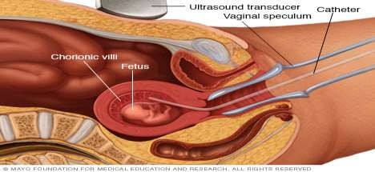
Genetic counseling
2. Chorionic villus sampling, or CVS, involves the removal and testing of a very small sample of the placenta during early pregnancy. The sample, which contains the same DNA as the fetus, is removed by catheter or a fine needle inserted through the cervix or by a fine needle inserted through the abdomen. The tissue is tested for genetic changes identified in an affected family member. Results are usually available within 2 weeks.

Slide 26
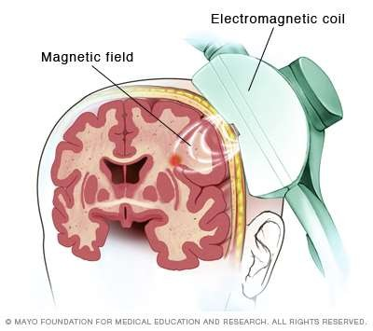
Treatment
Assessing stroke risk
Using a special ultrasound machine (transcranial), doctors can learn which children have a higher risk of stroke. This painless test, which uses sound waves to measure blood flow, can be used on children as young as 2 years. Regular blood transfusions can decrease stroke risk.
Vaccinations to prevent infections
Childhood vaccinations are important for preventing disease in all children.
Vaccinations, such as the pneumococcal vaccine and the annual flu shot, are also important for adults with sickle cell anemia.

Slide 27
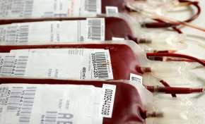
Treatment
Blood transfusions
Blood transfusions increase the number of normal red blood cells in circulation, helping to relieve anemia. In children with sickle cell anemia at high risk of stroke, regular blood transfusions can decrease the risk. Transfusions can also be used to treat other complications of sickle cell anemia, or they can be given to prevent complications.
Blood transfusions carry some risk, including infection and excess iron buildup in your body. Because excess iron can damage your heart, liver and other organs, people who undergo regular transfusions might need treatment to reduce iron levels.

Slide 28
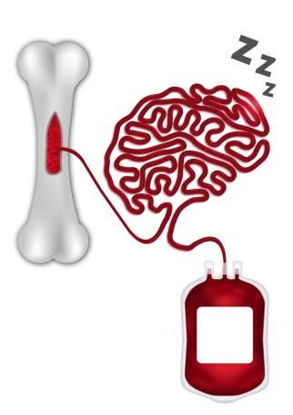
Bone Marrow Transplant
Bone marrow transplant, also known as stem cell transplant,
A bone marrow transplant involves replacing bone marrow affected by sickle cell anemia with healthy bone marrow from a donor.

Slide 29


